Slide 1
Homework 7

Slide 2
Biological problem
Planning the experiment
Publication
?
if you do not know what is required here
this will be very tricky to plan

Slide 3
Biological problem
Planning of the experiment
Publication
use BioAnalyzer for RNA QC
template quality control
find a pair of reference genes with a proper M value
proper reference genes
a pilot experiment to evaluate power of the test
statistically significant results
…
…
…
…
…
…
…
…
…
…
…
etc.….
This homework is designed to help you to make this list
which will then guide your experiment plan

Slide 4
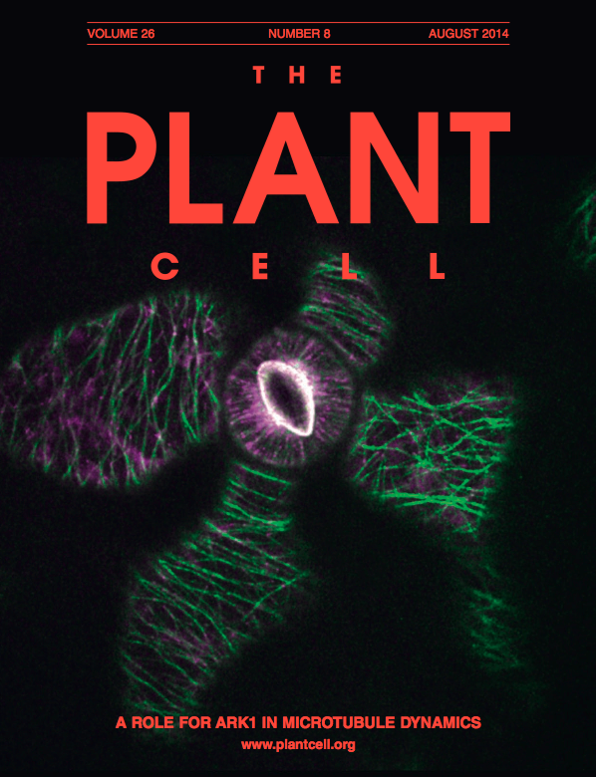
Group 1:
Reza
Jun
Anna
Shirin
Group 2:
Martin
Zaenab
Tina
Group 3:
Jule
Maite
Enrique
Kiran
Group 4:
Enid
Mohammad
Anders
Please write your report following the instructions for authors
from the journal assigned to your group

Slide 5
Homework
Please prepare ONE report:
Imagine an experiment for which you would use absolute and relative qPCRs (an example is on next slide, but you are most welcome to make up your own experiment)
Go to the site of the journal assigned to you and check instructions for authors
Follow these instructions to prepare a figure with your qPCR results, legend to the figure, Materials and Methods and if required also supplementary material
If you can not use your data (qPCR didn’t work) please use data of any of your colleagues.
Please include statistical analysis which would be required for the experiment you imagined
(not obligatory) If you want a personal feedback, please send the report to Alyona asap
(obligatory) Bring your report with you on Wednesday for the group work

Slide 6
here is an experiment I imagined:
a symbiotic bacteria was collected in the field
absolute qPCR was used to estimate amount of the bacteria in this sample
the bacteria was added to the pots with Arabidopsis plants. 10⁹ bacteria/pot
expression of TOR kinase was compared in roots of treated and untreated plants
please include also statistical analysis results

Slide 7
And again:
Report = your qPCR results and statistical analysis as they would have been included into a real manuscript
One-three sentences describing the results
A Figure with a qPCR chart, properly labeled
A legend to the figure
Materials and methods
Supplementary (if you think it is required)

