Slide 1
The very LAST homework

Slide 2
Plan well BEFORE you start your qPCR
BEFORE
boring and a lot of work
what statistical test you will need to perform and what is its power
estimate what sample size you will need (how many biological replicates)
what is the significance criterion
what is the magnitude of the effect
what are the assumptions for this test
comply with MIQE guidelines
even more boring and even more work!

Slide 3
happens all the time

Slide 4
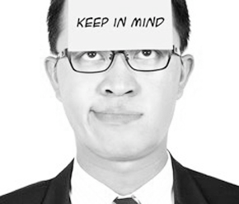
keep in mind the bigger picture

Slide 5
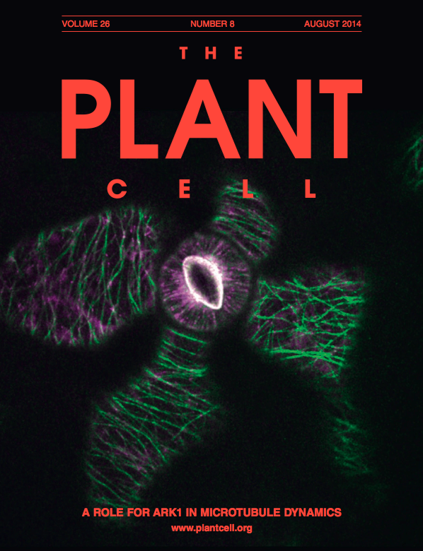
Group 1:
Reza
Jun
Anna
Shirin
Group 2:
Martin
Zaenab
Tina
Group 3:
Jule
Maite
Enrique
Kiran
Group 4:
Enid
Mohammad
Anders
Please write your report following the instructions for authors
from the journal assigned to your group

Slide 6
Homework
Please prepare ONE report:
Imagine an experiment for which you would use absolute and relative qPCRs (an example is on next slide, but you are most welcome to make up your own experiment)
Go to the site of the journal assigned for you and check instructions for authors
follow these instructions to prepare a figure with your qPCR results, legend to the figure, Materials and Methods and if required also supplementary material
if you can not use your data (qPCR didn’t work) please use data of any of your colleagues
Please include statistical analysis which would be required for the experiment you imagined
(not obligatory) If you want a personal feedback, please send the report to Alyona asap
(obligatory) Bring your report with you on Wednesday for the group work

Slide 7
here is an experiment I imagined:
a symbiotic bacteria was collected in the field
absolute qPCR was used to estimate amount of the bacteria in this sample
the bacteria was added to the pots with Arabidopsis plants. 10⁹ bacteria/pot
expression of TOR kinase was compared in roots of treated and untreated plants
please include also statistical analysis results

Slide 8
Report = your qPCR results and statistical analysis as they would have been included into a real manuscript
One-three sentences describing the results
A Figure with a qPCR chart, properly labeled
A legend to the figure
Materials and methods
Supplementary (if you think it is required)

Slide 9
What happens if you do not comply to the guidelines
wow! I got completely different results
Do everything from scratch and properly
You are done with experiments
you wrote the manuscript
you submit manuscript
it is accepted
reviewers reject it
it is sloppy, but still true
another group publishes contradicting results
YOURS, not your coauthors carrier will be at stake
You are asked to provide raw data
it is obviously not good enough
you can’t prove your conclusions
RETRACTION of the article

Slide 10
What happens if you do not comply to the guidelines
wow! I got completely different results
Do everything from scratch and properly
You are done with experiments
new hypothesis
you realised, that you messed up the set up
you wrote the manuscript
you submit manuscript
it is accepted
you published all required info. It is a problem of another group to explain, why their results are different
it is sloppy, but still true
another group publishes contradicting results
YOURS, not your coauthors carrier will be at stake
You are asked to provide raw data
it is obviously not good enough
you can’t prove your conclusions
RETRACTION of the article

Slide 11
Science retracts major Arabidopsis paper
Four out of five authors of a Science paper that the journal called a "breakthrough of the year" in 2005 have retracted it, saying that the data it was based on could not be replicated. The study was based on real-time PCR data, which researchers in the Umeå Plant Science Center lab where it had been performed found impossible to replicate.

Slide 12
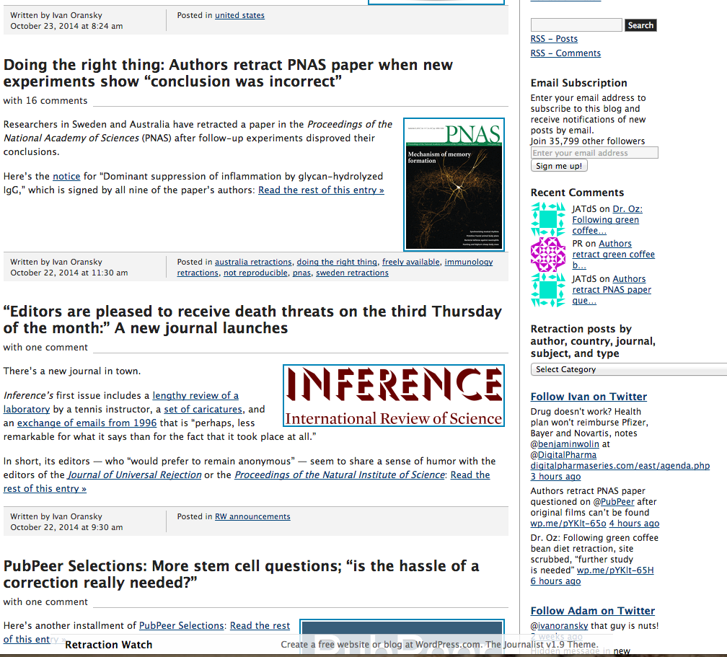
http://retractionwatch.com/

Slide 13
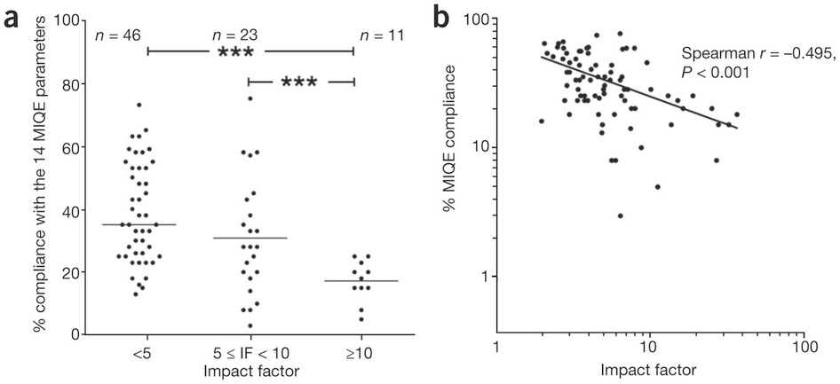
Relationship between compliance with MIQE guidelines and journal impact factor (IF)
Bustin et al., 2013. Nature Methods

Slide 14
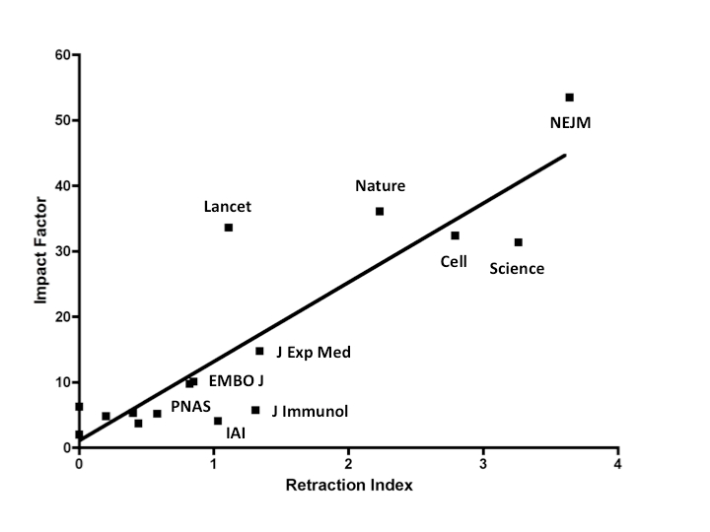
Relationship between compliance with MIQE guidelines and journal impact factor (IF)
Fang et al., 2011. Infection and Immunity

